Slide 1
Imbalanced dataset and ML methods on it
Instructor:
Behnoud Shafizadeh
30 May 2022

Slide 2
What is Imbalanced Data?
Imbalanced data typically refers to a problem with classification problems where the classes (labels) are not represented equally. Also, the classification will no be able to learn the decision boundary between minority class (negative or class 0) and majority calls (positive or class 1). This is shown in some interesting fields such as :
Fraud Detection, Spam Detection, Anomaly Detection, Outlier Detection, …
Causes of class imbalance
Biased Sampling
examples were collected from a narrow geographical region, or slice of time, and the distribution of classes may be quite different or perhaps even collected in a different way.
Measurement Errors
wrong class labels to many examples
examples were collected may have been damaged or impaired
Different types of imbalance dataset
Slight Imbalance: An imbalanced classification problem where the distribution of examples is uneven by a small amount in the training dataset (e.g. 4:6).
Severe Imbalance: An imbalanced classification problem where the distribution of examples is uneven by a large amount in the training dataset (e.g. 1:100 or more).
Major challenges made by imbalance dataset
- Accuracy is not appropriate. Also, it reflects the underlying class distribution. (solving by ROC and…)
Assigning distinct cost functions to training examples. (weighting cost function based on proportions of majority and minority classes or using cost sensitives algorithms such as logistic regression,…)
Resampling the minority and majority classes. (proposing different models of majority undersampling and minority upsampling,…)

Slide 3
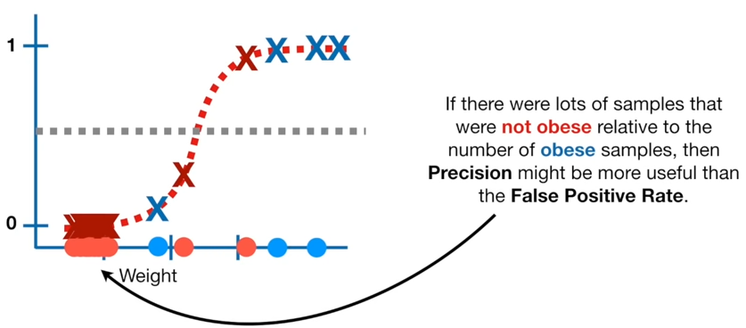
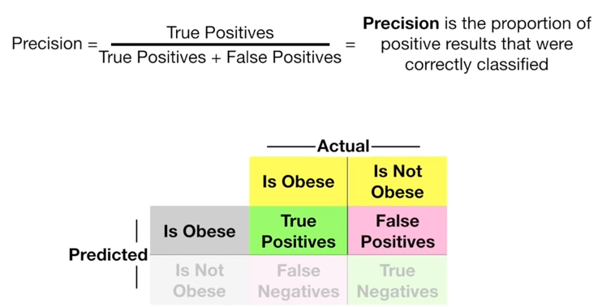
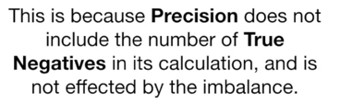
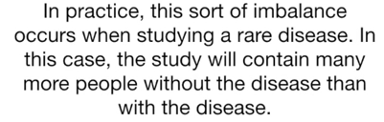
ROC with precision

Slide 4
Imbalanced Classification Model to Detect Mammography Microcalcifications
Mammography dataset
Detecting breast cancer from radiological scans
98% of microcalcifications are not cancer and 2% were labeled as cancer
Contains 6 feature:
Label :
Non-microcalcifications: negative case, or majority classes.
Microcalcifications: positive case, or minority class.
Target :
The focus of the problem is on detecting breast cancer from radiological scans, specifically the presence of clusters of microcalcifications that appear bright on a mammogram.
Area of object (in pixels).
Average gray level of the object.
Gradient strength of the object’s perimeter pixels.
Gradient strength of the object’s perimeter pixels.
Contrast, average gray level of the object minus the average of a two-pixel wide border surrounding the object.
A low order moment based on shape descriptor.
Intentions of ROC and AUC :
Minimize false positive rate
Maximize true positive rate
Choosing a threshold value as a cut-off between FPR and TPR

Slide 5
Imbalanced Classification Model to Detect Mammography Microcalcifications (evaluating different models)
Linear models:
Logistic Regression (LR)
Support Vector Machine (SVM)
Bagged Decision Trees (BAG)
Random Forest (RF)
Gradient Boosting Machine (GBM)
we can improve them with cost-sensitive classifiers. Some machine learning algorithms can be adapted to pay more attention to one class than another when fitting the model. These are referred to as cost-sensitive :
Cost sensitive models:
Logistic Regression (LR)
Support Vector Machine (SVM)
Random Forest (RF)
As a result, we can see cost sensitive algorithms have a better performance base on ROC AUC metrics compared to linear models. Furthermore, amongst them SVM classifier has a better result than others by : SVM mean scores (0.957) std scores (0.024)

Slide 6
A Gentle Introduction to Threshold-Moving for Imbalanced Classification
For those classification problems that have a severe class imbalance, the default threshold can result in poor performance. Specially, it affects (changes) the trade of between false positive and false negative rates
The default value for the threshold is 0.5, it means that:
Prediction < 0.5 = Class 0
Prediction >= 0.5 = Class 1
But this is not optimal threshold value.
So, We have two solutions for solving this issue : Precision-Recall curve , ROC curve (discussed before) . In fact, Tuning or shifting the decision threshold in order to accommodate the broader requirements of the classification problem is generally referred to as “threshold-moving”.

Slide 7
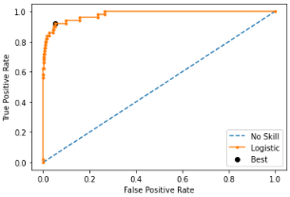
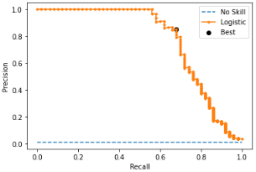
Optimal threshold on ROC&Precision-Recall curves
An optimal threshold, on the curve is closest to the top-left of the plot. Indeed, we can calculate the G-Mean for each threshold directly to find optimal point:
G-Mean = sqrt(Sensitivity * Specificity)
Best Threshold=0.016153, G-Mean=0.933
Unlike the ROC, Precision-Recall curve only focuses on the positive (minority class). Using F-measure to finding trade off between Precision and Recall. In fact, the score and threshold with the largest value will be selected as a optimal point.
F-Measure = (2 * Precision * Recall) / (Precision + Recall)
Best Threshold=0.256036, F-Score=0.756

Slide 8
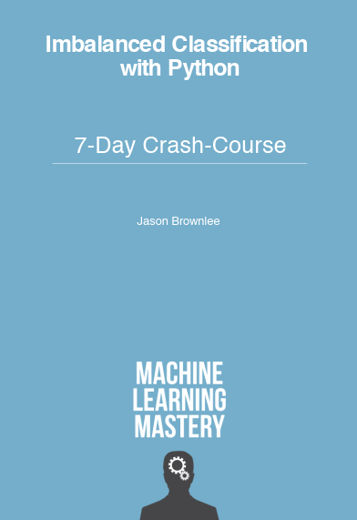

Jason Brownlee
https://machinelearningmastery.com/category/imbalanced-classification/

Slide 9
Thanks for your consideration.

